Slide 1
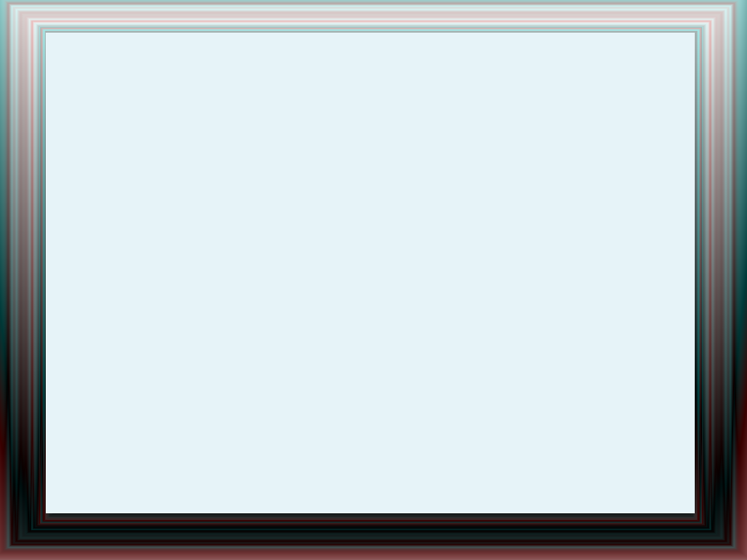
Android Development I, ITI-123
Brian Williammee, Instructor

Slide 2
Housekeeping
Name Verification
Roster Check
Attendance
Breaks on the hour
Inclement Weather Policy
No homework/tests, just suggested exercises

Slide 3
Who am I?
B.S. in Computer Science, University of Maryland, College Park
6 years software development experience
  3 years with Android
6 apps published
  750,000 downloads

Slide 4
Who are you?
Has everybody taken Java 1 or equivalent?
What other coding have you done?
What do you want to learn?

Slide 5
What are we going to cover?
Event-driven app development
UI widgets and layouts
Web content and images
How to install and publish apps

Slide 6
What are you going to learn today?
What is Android? (5 min)
Why Android? (5 min)
How to create your first app ('til closing)

Slide 7
What is Android?
Open source operating system based on Linux
Maintained primarily by Google
Android apps run Java, but not exactly the same Java as Java SE
  Same syntax, slight library differences
  Google and Oracle argued about this

Slide 8
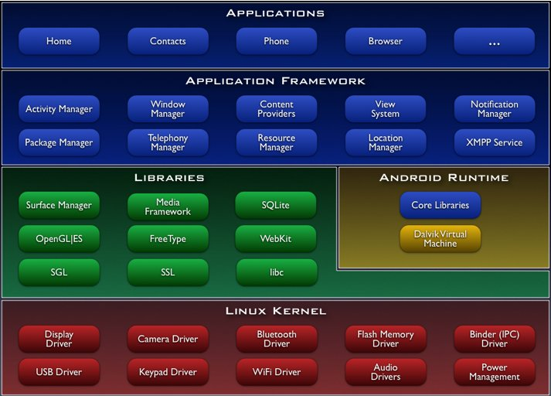
What is Android?

Slide 9
Why Android?
Android has 51% smartphone market share (comScore, May 1, 2012)
  iPhone: 30.7%
Full control over device
  You can replace the email or contacts app
Very easy to publish
  Unlike some smartphone ecosystems

Slide 10
Now for the fun part
Let's get coding!

